Slide 1
Twitter Emoji Analysis
Adam Pesch, Christian Palko, Conor Sosh, Eunice Lee
Github: https://github.com/HomelessSkittle/RevProject2-TeamACCE

Slide 2
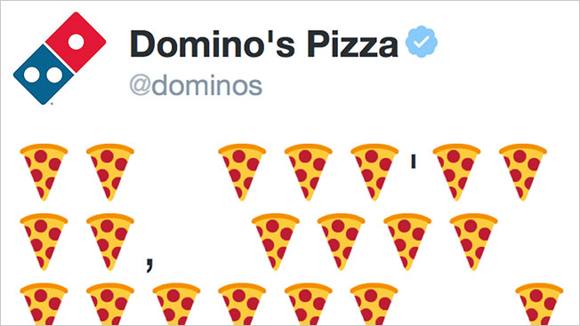
Project Goals
Overall goal
Analyze/Explore emoji usage
Contexts to focus on: Overall popularity, different “Twitter specified” categories, specific users, and different time periods
Subgoals:
Learn the Twitter API
Become more familiar with DataFrames/DataSets

Slide 3
Major Roadblocks
Unfamiliar with Twitter API
Parsing Unicode with Regex
All the little things:
Where do we get historical twitter data?
What do I (or can I) do to this dataframe to get this information out?
Why is GitHub so annoying?

Slide 4
Roadblock 1 - The Twitter API
Twitter’s API, while expansive, and “well” documented, is a nightmare to dig through the first time
Examples for expanding the Tweet Object are rather monolithic, and hard to trace through
Terms get confusing quickly
Example: You have to add expansions to your query string, and add additional fields on the expansion to get additional data
Each bolded word has its own documentation page, with various subpages detailing the things you can actually get.

Slide 5
Roadblock 2 - Unicode/Regex
We’ve worked with Regex before, but we had to dig even deeper for our project
Coupled with ranges of two character Unicode sequences things got out of hand quickly
Blocks:
“Emoticons”
“Miscellaneous Symbols and Pictographs
“Supplemental Symbols and Pictographs
Translation: Match a single, two character sequence NOT in one of these three Unicode ranges

Slide 6
Data Used
Sample Stream Data (1/100 of real-time tweets)
Read in real-time
Stored in static DataFrames and read from those
Historical Data / Rehydrated Tweet Datasets:
All Tweets from Mar 21st 2006 - July 31st 2009 (1.5 years)
https://catalog.docnow.io/datasets/20200519-twitter-historical-dataset/
All Tweets from June 21st, 2015, 6:00pm-7:00pm UTC (Every 15 minutes)
https://archive.org/details/twitterstream

Slide 7
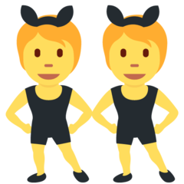

Overall Simplifications
We have excluded “Zero-Width-Joiner Emoji Sequences”, which are combinations of multiple base-emojis separated by zero-width characters and displayed as a single emoji (if supported).
The vast majority of popularly used emojis are not ZWJ sequences.
ZWJ still has limited or no support on many platforms.
Example:
Because of this simplification, some partial emojis, such as skin-tone modifiers, are captured as separate emojis.
Example:
🏽🏿🏻
https://emojipedia.org/emoji-zwj-sequence/ http://www.emojistats.org

Slide 8


Q1. Most/Least Popular Emoji
Most Used Emoji
Least Used Emoji
Used Sample Stream Data
Approximately 760,000 tweets
Created values for emoji/non-emoji
Used DataFrame:
SELECT from text
FILTER with regex to get tweets with emojis from text
REGEXP_REPLACE to remove non-emojis
& add a space before new emoji
SPLIT on white spaces to get an array of emojis
EXPLODE to create a column containing all array elements in each row
GROUP BY and COUNT emojis

Slide 9
Q2. Most Popular Emoji Right Now!
Alternate Title: Demo time!

Slide 10


Q3. Avg Count of Emojis per Num of Words
Created DataFrames from the data used in Question 1
Emoji Counts
Same algorithm as Q1 and Q2, without the GROUP BY emoji
Word Counts:
REGEXP_REPLACE to exclude spaces, control characters (%, @, <,> …)
FILTER to select all digits and letters
COUNT words
Emoji Counts / Word Counts
367,157 Emojis
5,333,870 Words
≅
0.07 Emojis per word

Slide 11
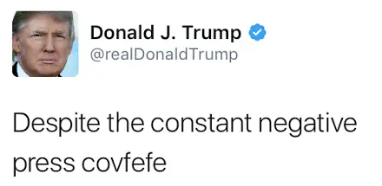
Simplifications
When comparing word-count to emoji-count, the word-count regex matches a fairly broad range of character sequences. This serves to not exclude what are ‘effectively’ words, such as “RT” which is often used to abbreviate “retweet”.
This can also match typos and unintended sequences of characters
E.g. In the tweet: “I love this asdf movie!”, “asdf” would be captured as a word.
Allows for matching non-English words, like “en” or “y” (Spanish)
example:“covfefe”

Slide 12
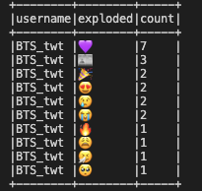
Q4. Most Mentioned Users with Emoji
Used Sample Stream Data
Added Request Query Parameter: ?tweet.fields=entities&expansions=entities.mentions.username
SELECT “text”, “data.entities.mentions.username”
Repeat Q1
GROUP BY username and emojis
COUNT emojis

Slide 13
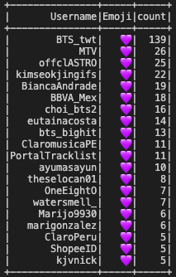
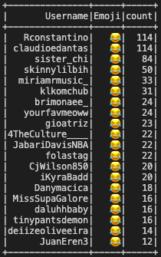
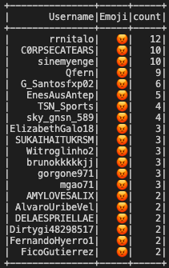
Q4. Most Mentioned User By Emoji in the Tweet
Adapted code to allow specification of a single emoji rather than all emojis.
Determine which user is most mentioned in the same tweet as the given emoji.
Feed streamed data into, and then read from, a static DataFrame to allow for analysis on different emojis from the same data.

Slide 14
Q5. Emoji Usage in Different Categories
Used Sample Stream Data
Added Request Query Parameter: ?tweet.fields=context_annotations
SELECT “text”, “domain.name” (=categories)
Repeat Q1
GROUP BY categories and emojis
COUNT emojis

Slide 15
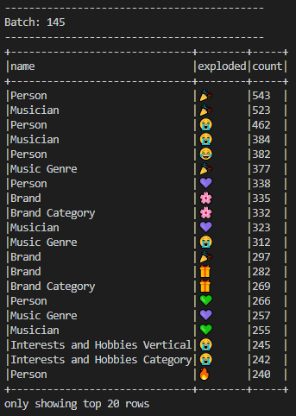
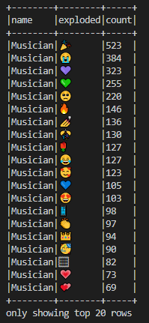
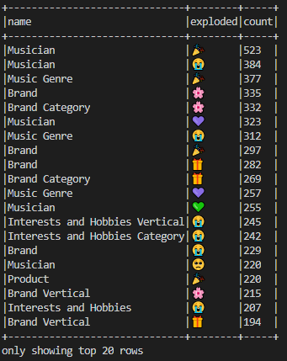
Q5. Results
1.All Categories:
2. Only Musicians:
2. No Persons

Slide 16
Q6. Emoji Usage in Different Geolocations
Used Sample Stream Data
3 hours total (478,000 tweets)
Added Request Query Parameter: ?tweet.fields=geo&expansions=geo.place_id
SELECT “text”, “places.country”
Repeat Q1
GROUP BY countries and emojis
COUNT emojis
Created CLI to view results by user’s input
Caveat:
Location information about where a tweet was sent from is an opt-in feature for users.
Less than 1% of tweets include location data.
https://journals.sagepub.com/doi/10.5153/sro.3001

Slide 17
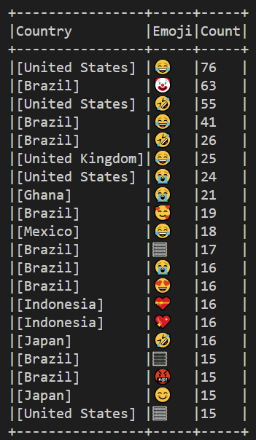
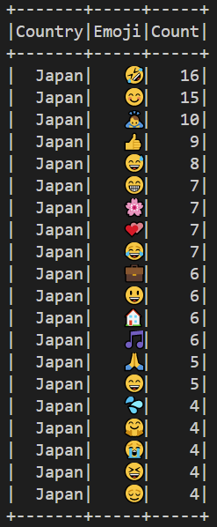
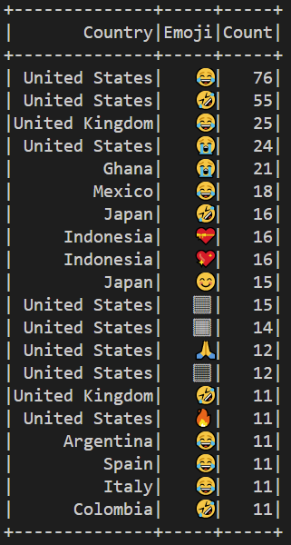
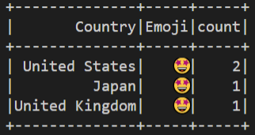
Q6. Result
1.All Countries:
2. One Country:
3. Exclude: Brazil
4. Search Emoji:

Slide 18

Q7. Emoji Usage in Historical Data (Pt. 1)
Used data gathered by Daniel Gayo-Avello from the University of Oviedo
Link to the data
Repeat Q1 for each data set
FILTER the text, GROUP BY emojis and COUNT them
Our largest dataset by FAR
Timespan: ~3 years
Quantity: 1.5 billion tweets
Results:

Slide 19
Q7. Emoji Usage in Historical Data (Pt. 1)
Several (possible) reasons for these results:
We are using Unicode 13. 2006 - 2009 would have used Unicode 5
It wasn’t until approximately April 2014 when Twitter added emoji to its web client
Possible improvements?
Alter the unicode we search for? Possibly. Unsure what unicode twitter returns when we rehydrate the tweets.
Search for “text emoji” instead
:) o_o XD

Slide 20

Q7. Emoji Usage in Historical Data (Pt. 2)
5 Minutes of 2015 Data
4 Hours of Current Data
Let’s try this again…
Use data from 2015
~15,000 tweets
Emojis supported on web client, and more popular among people in general, so we expect to see some results
Data taken from the Internet Archive’s Twitter Stream Archive
Link to all possible data sets

Slide 21

THANK YOU

